Slide 1
Breast Cancer Classification & Detection
Domain: Disease Diagnosis Helper

Slide 2
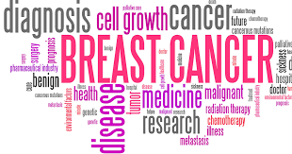
MOTIVATION
Breast cancer is the most common cancer amongst women in the world. It accounts for 25% of all cancer cases and affected over 2.1 Million people in 2015 alone. It starts when cells in the breast begin to grow out of control. These cells usually form tumors that can be seen via X-ray or felt as lumps in the breast area. Early diagnosis significantly increases the chances of survival.

Slide 3
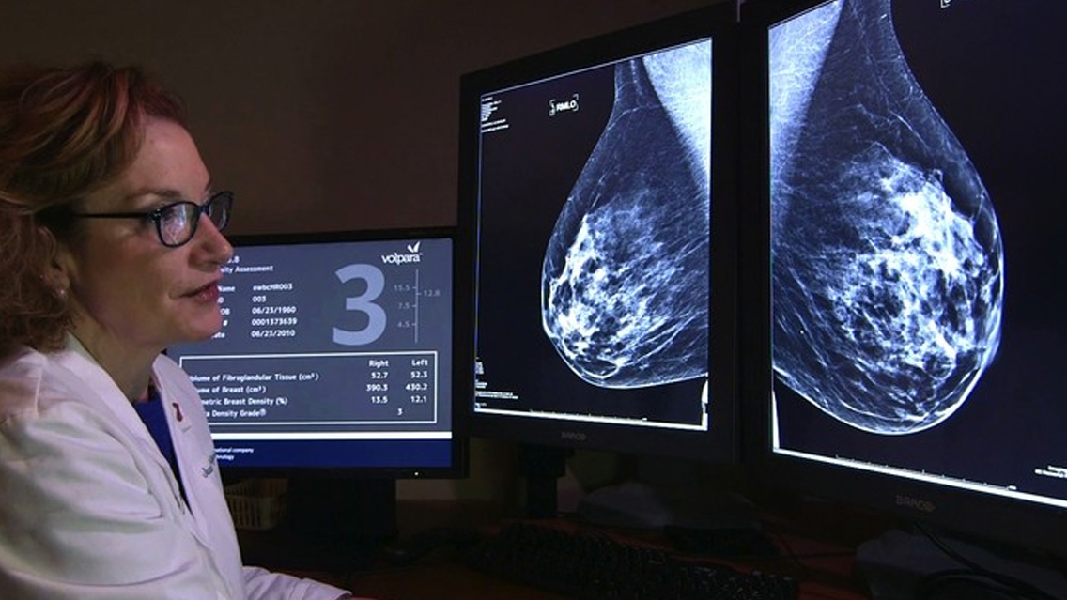
CHALLENGES
(Medical Challenges)
The key challenges against its detection is how to classify tumors into malignant (cancerous) or benign (noncancerous). A tumor is considered malignant if the cells can grow into surrounding tissues or spread to distant areas of the body. A benign tumor does not invade nearby tissue nor spread to other parts of the body the way cancerous tumors can. But benign tumors can be serious if they press on vital structures such as blood vessels or nerves.

Slide 4
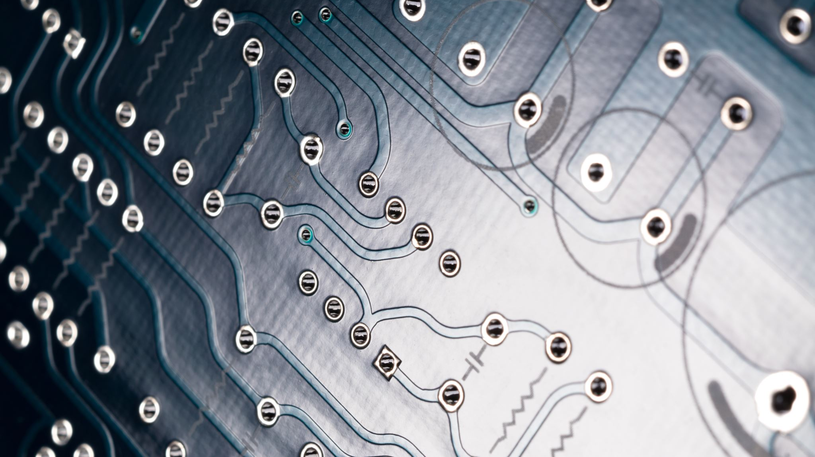
Why this Project?
(Substantiation of Project Choice)
In the recent light of increased amounts of death and new cases, we think that as a reinforcement to our learning of these concepts of PRML (Pattern Recognition & Machine Learning), we ought to contribute to the society in any way possible. Science & Technology has helped increase the estimation and recovery chances to a greater extent and our team believes we can implement that to explore this domain more.

Slide 5

Why PRML techniques for this problem?
Machine Learning technique can dramatically improve the level of diagnosis in breast cancer. Research shows that experienced physicians can detect cancer by 79% accuracy, while a 91 % (sometimes up to 97%) accuracy can be achieved using Machine Learning techniques.

Slide 6
What we want to do in this Project?
Background on Training Set: Features are computed from a digitized image of a fine needle aspirate (FNA) of a breast mass. They describe characteristics of the cell nuclei present in the image.
Project Work: In this project, we plan to classify tumors into malignant (cancerous) or benign (non-cancerous) using features obtained from several cell images (test cases).
This idea of classification of cancer was chosen by reference in Prof. Andrew NG’s lectures series of Machine Learning.

Slide 7
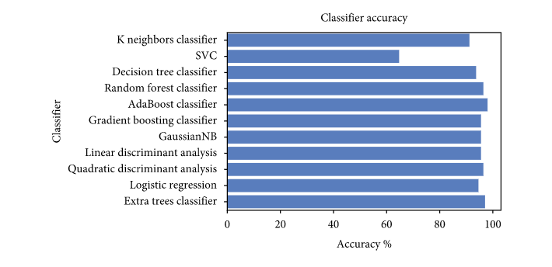
Existing Solutions
References for Existing Solutions with State of the Art Models
The following models are the most used implementations in recent state of the art model machine learning techniques. The following slide shows the models which we plan to implement.

Slide 8
What we Planning to implement?
We plan to implement it using different models and test the accuracy for the respective models:
Logistic Regression
K-Means Clustering
Decision Tree Classifier
Random Forest Classifier
If time permits, we want to try out SVM model implementation. (We will be learning it in further course)
LOGISTIC REGRESSION
DECISION TREE CLASSIFIER
RANDOM FOREST CLASSIFIER
SUPPORT VECTOR MACHINE

Slide 9
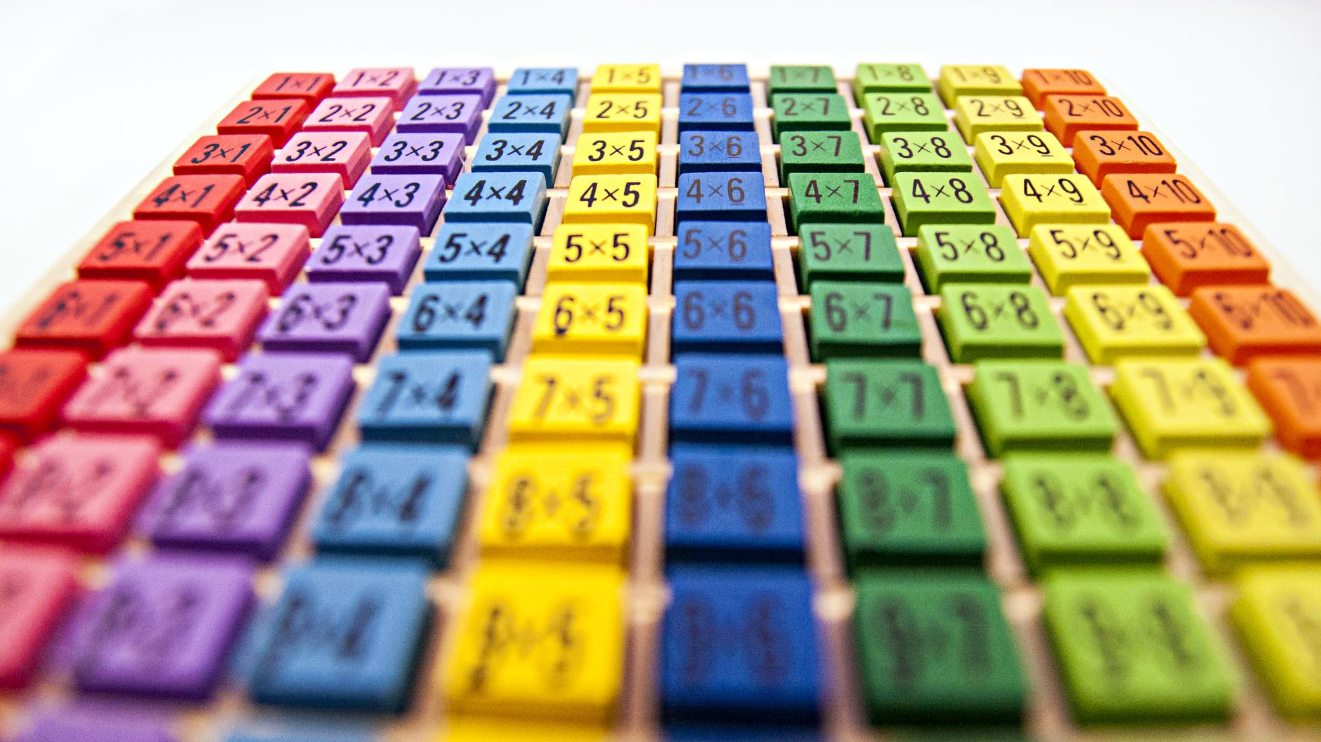
Libraries used
numpy : for working with arrays in a efficient way.
pandas : for data analysis and manipulation.
Matplotlib : for plotting graphs
Scikit learn : for featuring various classification, regression and clustering algorithms
Seaborn : a wonderful visualization library ,it has several kinds of plots through which it provides the amazing visualization capabilities. Functionalities of seaborn used :-
LabelEncoder : For encoding the levels of categorical features into numeric values.
Train_test_split : For splitting data arrays into two subsets: for training data and for testing data.
StandardScaler : For feature scaling
LogisticRegression : Implements Logistic Regression
DecisionTreeClassifier: Implements Decision Tree Model
RandomForestClassifier: Implements Random Forest Model
Confusion_matrix : Used to evaluate the performance of a classification model through the calculation of performance metrics like accuracy

Slide 10
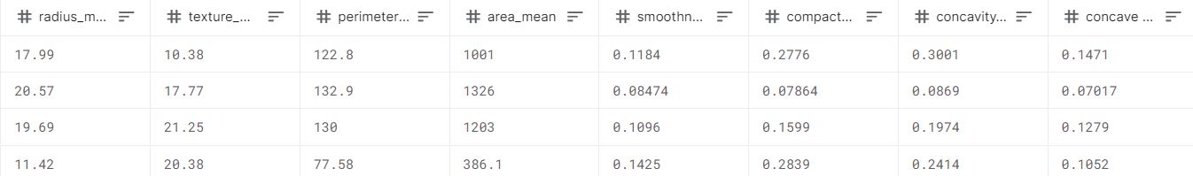
Fixation on Dataset
We looked at very renowned platforms like Kaggle and upon some of web scraping we came across few datasets as listed below.
Breast Cancer Wisconsin (Diagnostic) Data Set
We wish to implement above mentioned models using this Dataset and tweak parameters to get maximum accuracy for our model.

Slide 11
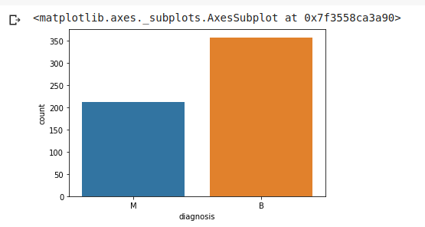
Training Set Visualization
#Visualize this count
sns.countplot(df['diagnosis'],label="Count")
On y-axis we have the count of malignant and benign
We can see there are more patients with benign cells than patients with malignant cells
Malignant (cancerous) & Benign(non-cancerous) diagnosis

Slide 12
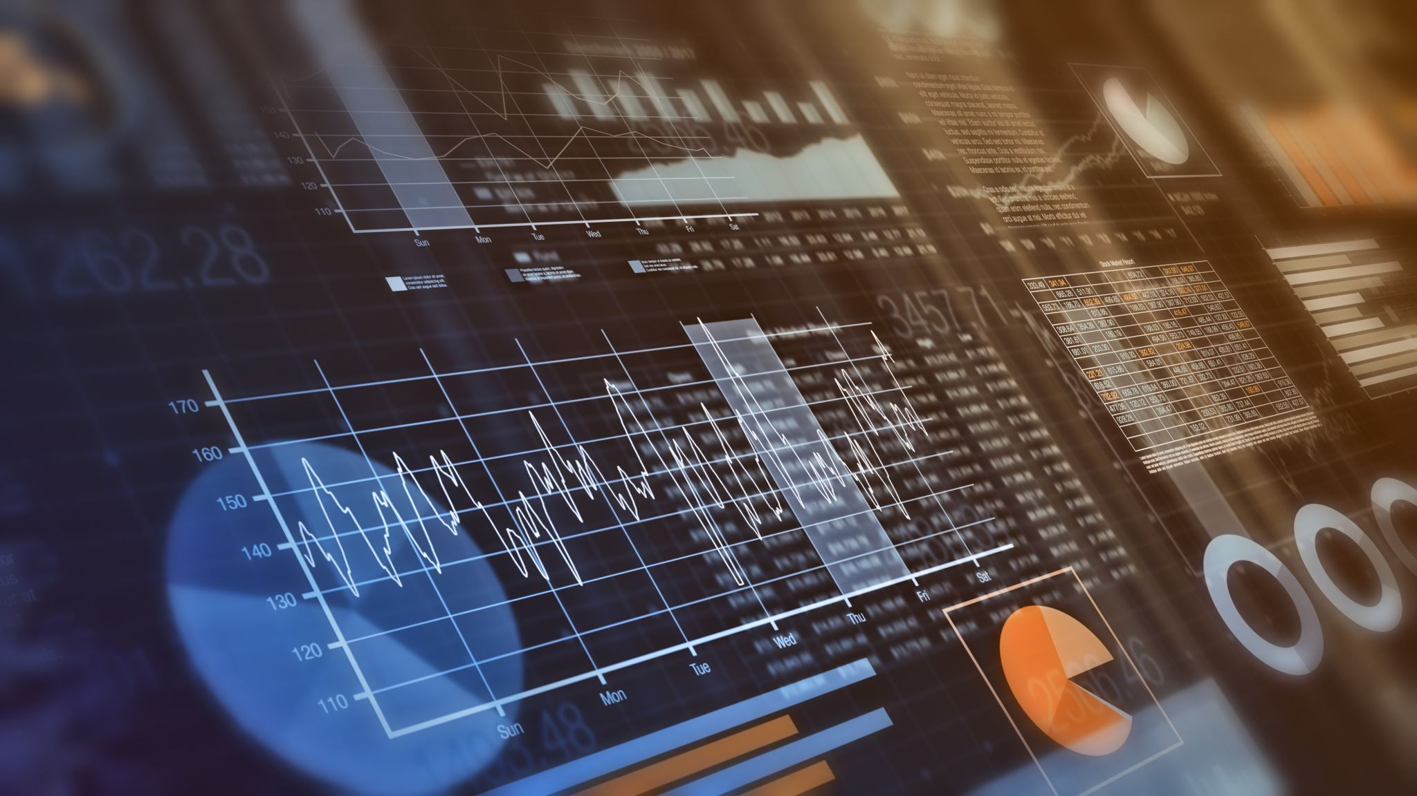
Understanding the Environment
The environment plays a vital role in the implementation phase and with that notion we tried to understand all the aspects of the project. Some of them are as follows:
Parameters of data set,
Splitting of data for training and testing,
Algorithms used for predicting Benign/Malignant,
Correlations between parameters, features in data set
Data Normalization, etc.

Slide 13
Parameters in Dataset
Last time we discussed about the dataset and its feature scaling. Let’s look upon some of the data features we will be using for classification in our project.
General Parameters: Id, diagnosis
Shape Related Parameters: radius_mean, texture_mean, perimeter_mean, area_mean
Texture Related Parameters: smoothness_mean, compactness_mean, concavity_mean, concave points_mean, symmetry_mean, fractal_dimension_mean, radius_se, texture_se, perimeter_se, area_se, smoothness_se, compactness_se, concavity_se, concave points_se, symmetry_se, fractal_dimension_se, radius_worst, texture_worst, perimeter_worst, area_worst, smoothness_worst, compactness_worst, concavity_worst, concave points_worst, symmetry_worst, fractal_dimension_worst

Slide 14
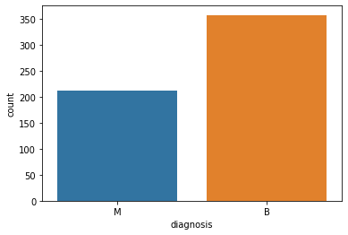
Data Visualization (Pre-Processing)
When we started the preprocessing of the data, the adjacent graph shows the division of total count into tumor being Malignant and Benign.
The Blue (M) is the Malignant and the Orange (B) is the Benign.

Slide 15
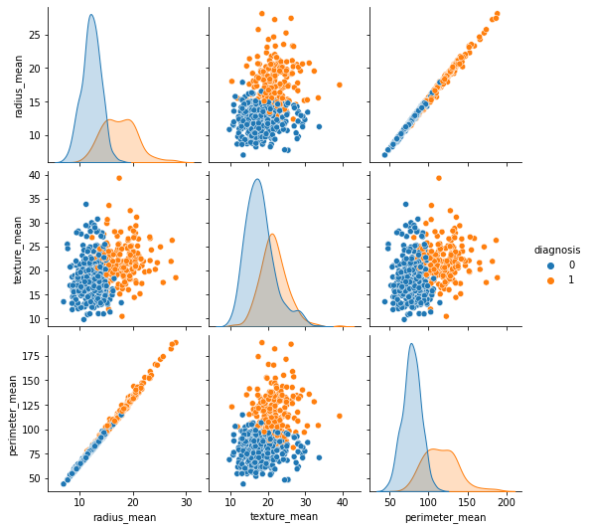
Pair Plotting
DATA Visualization Extended
During the pre processing of the data, the adjacent graphs shows the pairwise plotting across various data features vectors.
On the Y-Axis is the Radius Mean, Texture Mean, Perimeter Mean
On the X-Axis is the Radius Mean, Texture Mean, Perimeter Mean

Slide 16
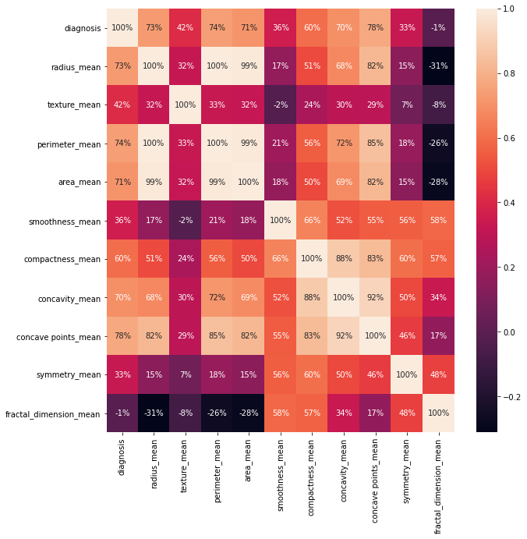
Correlation Heatmap
This figure clearly shows how the correlation is spreaded across various features.
This helps us to get a holistic view of the data features and further helps us to choose models and design models accordingly.

Slide 17
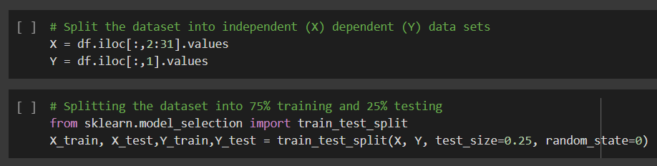
Data Splitting - Training & Testing Set
The above code snippet depicts that we have splitted the dataset into Training & Testing Set. 75% of dataset is set for Training and remaining 25% is set for Testing.
This has been implemented using Scikit Learn library.

Slide 18
Machine Learning Algorithms
The environment plays a vital role in the implementation phase and with that notion we tried to understand all the aspects of the project. Some of them are as follows:
Logistic Regression (Linear Regression)
Kneighbors Classifier (K-Means Classification)
Support Vector Machines (Linear Classification)
As per the concepts taught till now, we thought to implement the above models on our dataset and try to achieve least loss and more accuracy.
By tweaking the split of dataset into training and testing datasets, we observed that there was a variation of accuracies and when split the dataset in 3:1 ratio, we could achieve maximum accuracies across different models.

Slide 19
Overview of K-Nearest Neighbors Algorithm
KNN is a Classification algorithm which we can also be used for regression purpose.
The KNN algorithm assumes that similar things exist in close proximity. In other words, similar things are near to each other.
For predicting the class of any point, we calculate the distance or score to every point and get k - nearest points and give the classification result.

Slide 20
Overview of SVC (Linear) Algorithm
The support vector machine is a model used for both classification and regression problems though it is mostly used to solve classification problems.
The objective of a Linear SVC (Support Vector Classifier) is to fit to the data you provide, returning a "best fit" hyperplane that divides, or categorizes, your data.
From there, after getting the hyperplane, you can then feed some features to your classifier to see what the "predicted" class is.
The algorithm creates a hyperplane or line(decision boundary) which separates data into classes. It uses the kernel trick to find the best line separator (decision boundary that has same distance from the boundary point of both classes). It is a clear and more powerful way of learning complex non-linear functions.

Slide 21
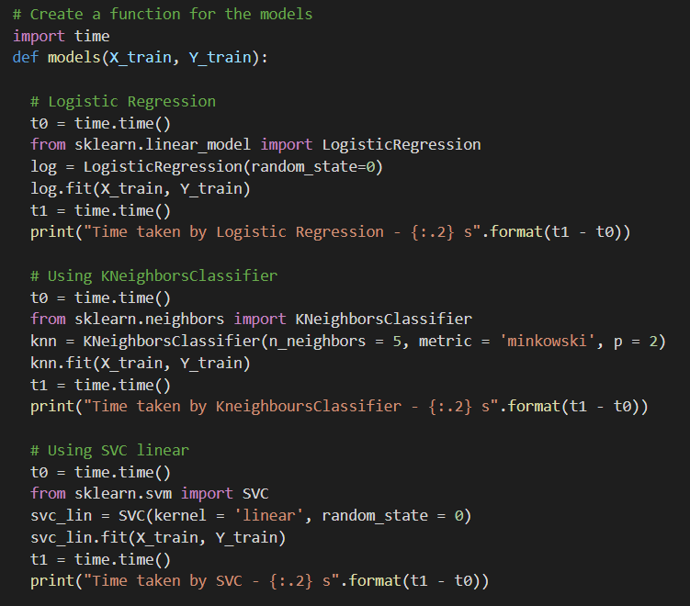
Models
Implementation

Slide 22
Models Implementation
contd.
Using functionalities of sklearn libraries we implemented prior mentioned models. The code snippet in previous slide is the the model implementation.
So what do we benefit from testing our data on different models ?
It gives a holistic sense on factors like which model takes less time to train, which model consumes less computing power, which model gains maximum accuracy, etc.
After culmination these factors, we try to tweak our models with different parameters to achieve maximum accuracy.

Slide 23
Comparison & Substantiation of Accuracies
Model | Accuracy (out of 1) | Time Taken
Logistic Regression | 0.9906103286384976 | 0.025 s
K-Means Neighboring Classifier | 0.9765258215962441 | 0.0025 s
SVC Linear | 0.9882629107981221 | 0.0052 s
The following table shows the accuracies across different models. These have varied due to factors like dataset, features of dataset, outliers, etc.
We can clearly see that there is a trade-off between accuracy and time taken (computation time) for a given model.

Slide 24
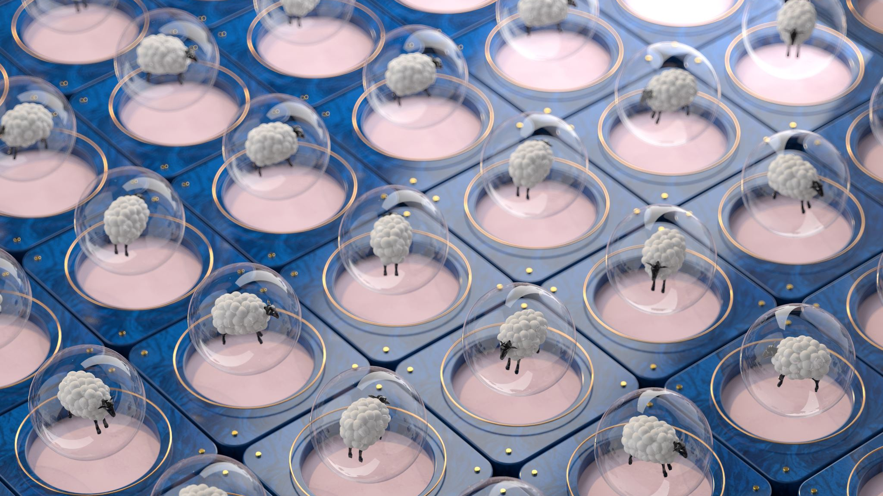
Future Models to be Implemented
With the reference to above models implemented, we plan to implement further models (listed below) to get better detection from our dataset.
Support Vector Machines (Radial Basis Classifier)
Gaussian Naive Bayes ()
Decision Tree Classification
Random Forest Classification
We expect to test these models compare accuracies and try to substantiate the results. This will help us to find the factors more clearly and achieve better accuracies.

Slide 25
References
References for Existing Solutions with State of the Art Models
Breast cancer detection by leveraging Machine Learning
Breast Cancer Wisconsin (Diagnostic) Data Set
Building a Simple Machine Learning Model on Breast Cancer Data
Biology behind Breast Cancer and other Components
References for Deep Learning Techniques used for Breast Cancer Classification & Detection

